Slide 1
Section Introduction
Anuranjan Srivastava (codersaty)

Slide 2

Git Basics
Now that we have learned about the terminal, we will start to use Git.
We begin with a little bit of theory behind the Git workflow and how it connects together.
Then, we learn some of the basic commands to use in Git.

Slide 3
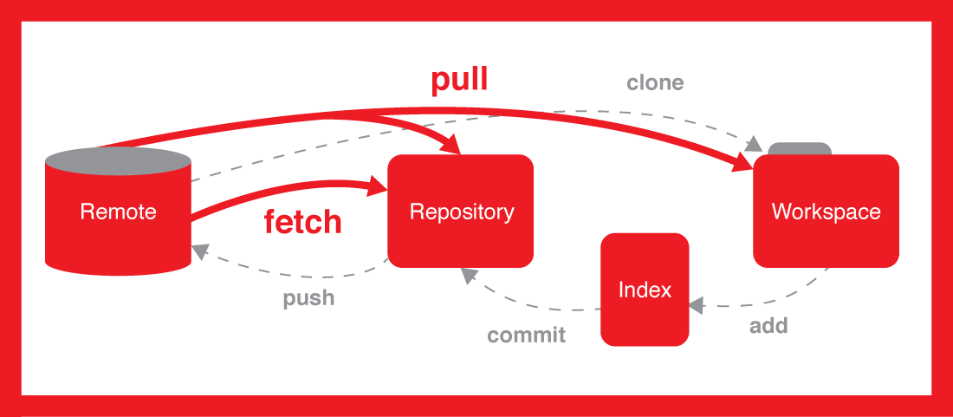
Git Theory
Before using Git, we spend some time learning how Git connects and works from start to finish
We learn about multiple components, such as the ‘staging area’, and committing.

Slide 4
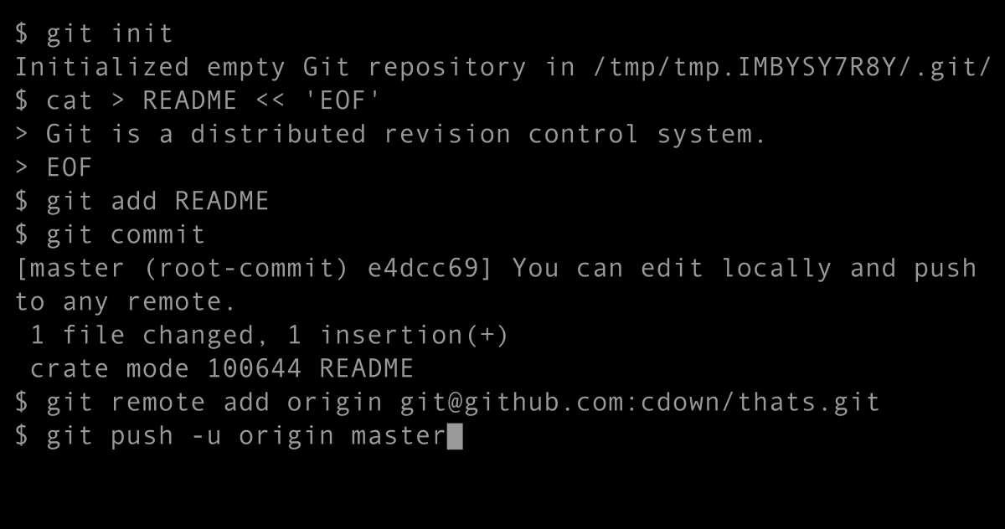
Git Commands
Finally, we learn all of the different basic commands we can use in Git.
On top of learning the commands, you will also learn the concept behind each command, and what it does.

Slide 5
Lets get Started!
Anuranjan Srivastava(codersaty)

